Slide 1

Literacy and closing the reading gap

Slide 2
Session Objectives
Look at the position of literacy within the curriculum as one of shared professional responsibility
Critically discuss research into improving literacy outcomes and closing the reading gap
Consider ways to address inequalities in literacy attainment within our subject disciplines

Slide 3
Essential Readings
Department for Education (2023) The Reading Framework
1. Machin, S., McNally, S., & Viarengo, M. (2018) Changing how literacy is taught: Evidence on synthetic phonics. American Economic Journal: Economic Policy, 10(2), pp.217-241. https://doi.org/10.1257/pol.20160514.
2. Moss, G. (2021) Literacies and social practice: sociological perspectives on reading research, Education 3-13, 49(1), pp. 41-51, DOI: 10.1080/03004279.2020.1824701
3. Education Endowment Foundation (2018) Improving Literacy in Secondary Schools Guidance Report. [Online] Accessible from: https://educationendowmentfoundation.org.uk/education-evidence/guidance-reports/literacy-ks3-ks4 [retrieved 17 August 2023].

Slide 4
Subject and Curriculum
To access the curriculum, early literacy provides fundamental knowledge; reading comprises two elements: word reading and language comprehension; systematic synthetic phonics is the most effective approach for teaching pupils to decode (ITTECF3.9)
Every teacher can improve pupils’ literacy, including by explicitly teaching reading, writing and oral language skills specific to individual disciplines (ITTECF3.10)
Department for Education, 2024

Slide 5
Considering our own language…
1. Do you have a favourite ‘filler’ that you use a lot – e.g. ‘you know’, ‘I mean’, ‘like’, ‘well’, ‘um’, ‘er’?
2. Do you have particular words for ‘good’ and ‘bad’?
3. Do you have words and phrases that you like, and use a lot as a teacher? (What words/phrases would your students say were typical of you?)
4. Are there certain words that you have trouble pronouncing or writing, or whose meaning you have trouble remembering within your subject specialism?

Slide 6

Why is it important to consider our own literacies in initial teacher training?

Slide 7

Your language is unique, like your fingerprints.
(Goddard, Keen, Shuttleworth and Green, 1991)

Slide 8


Slide 9
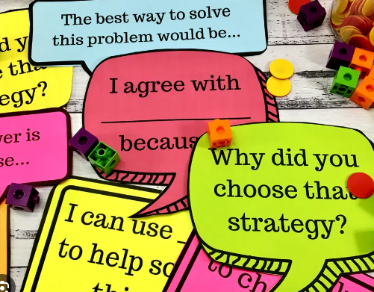
Disciplinary Literacy
What is unique about
your subject discipline
in terms of
Speaking and Listening?
Reading?
Writing?

Slide 10
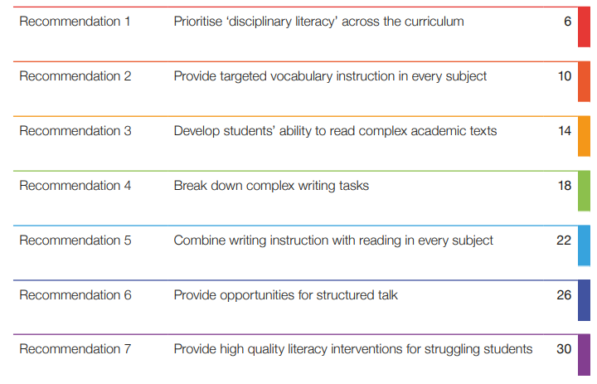
A disciplinary literacy model (EEF, 2018)

Slide 11
What is literacy?
In 2001, George Bush suggested: ‘You teach a child to read and he or her will be able to pass a literacy test.’
(cited in Yandell, 2008, p.2)

Slide 12
What is literacy?
Young people who leave school without good literacy skills are held back at every stage of life. Their outcomes are poorer on almost every measure, from health and wellbeing, to employment and finance. The most recent estimates suggest that low levels of literacy cost the UK economy at least £20 billion a year.
(EEF, 2018, foreword by Sir Kevan Collins)

Slide 13

(Wong, 2021)

Slide 14
What is literacy?
Beliefs about language are tied up with beliefs about moral ways to live.
(McEnery, 2006)

Slide 15

What is literacy?
Literacy is the ability to read, write, speak and listen in a way that lets us communicate effectively and make sense of the world.

Slide 16
Reading
Writing
Speaking and listening

Slide 17

How have you experienced speaking and listening modelled and developed in your subject discipline
Lessons you have observed?
Lessons you have taught?

Slide 18
Back-and-forth interactions with children…
• thinking out loud, modelling new language for children
• paying close attention to what the children say
• rephrasing and extending what the children say
• validating the children’s attempts at using new vocabulary and grammar by
rephrasing what children say if necessary
• asking closed and open questions
• answering the children’s questions
• explaining why things happen
• deliberately connecting current and past events (‘Do you remember when…?’)
• providing models of accurate grammar
• extending children’s vocabulary and explaining new words
• connecting one idea or action to another
• helping children to articulate ideas in well-formed sentences.
…Form the foundations for language and cognitive development
(DfE, 2023, p.23)

Slide 19

The importance of reading

Slide 20
The simple view of reading
Reading has been described as the product of decoding and comprehension, a model first proposed by Gough and Tunmer in 1986, who called it the Simple View of Reading.
Children need both good language comprehension and good word reading to become good readers.

Slide 21
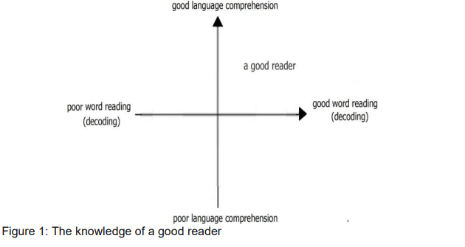
(DfE, 2023, p.18)

Slide 22


Supporting readers: What could be done?
Mia and George are in Year 7, although they struggled with reading at primary school they did not receive the support they needed at KS2.
Mia and George are now faced with a huge amount of reading in every lesson – in one day their peers read about the Norman invasion in history, a supermarket visit in French, cell structure in biology and they read ‘Macbeth’ in English. Mia and George cannot achieve success at school because their progress depends upon their learning academic vocabulary – and this depends on their ability to decode new words rapidly. Their motivation to learn and attitude towards school are at the lowest possible level. They are demoralised and have become recalcitrant. They have no choice but to hide the fact they cannot read. George disrupts lessons so he can be sent out of class; Mia switches off in lessons and then copies her friend’s work.

Slide 23
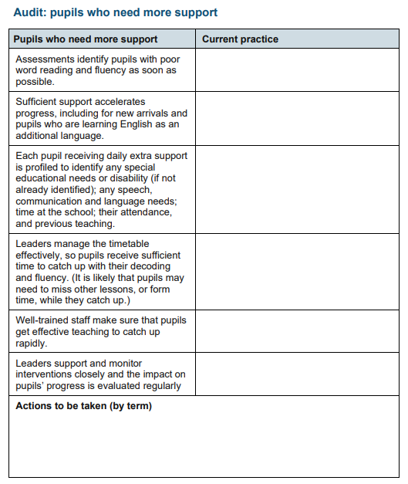
(DfE, 2023, p.76)

Slide 24
Reading 1: Machin, S., McNally, S., & Viarengo, M. (2018) Changing how literacy is taught: Evidence on synthetic phonics. American Economic Journal: Economic Policy, 10(2), pp.217-241
‘…it is more difficult to improve the reading scores for students who speak nonstandard English at home’ (Machin, McNally and Viarengo, 2018, p240)
‘…closing literacy gaps based on disadvantage and (initial) language proficiency by family background’ (Machin, McNally and Viarengo, 2018, p240)

Slide 25
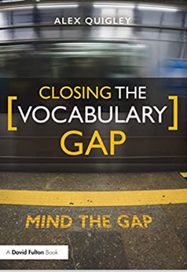
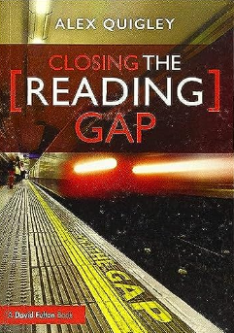

Slide 26
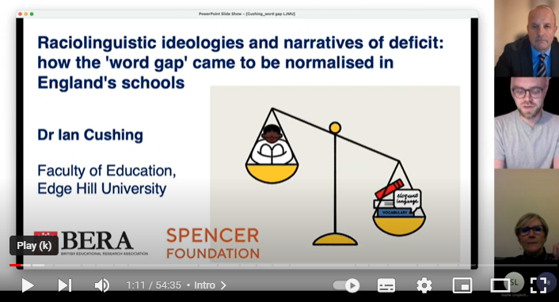
Problematising ‘gap’ discourses

Slide 27
Word gap ideologies are rooted in deficit perspectives of language which claim that minoritised speakers do poorly in school not because of structural inequality but because of a cultural, cognitive and linguistic deficit located within the speakers, their families, and their communities
(Cushing, 2022, p.5)

Slide 28


Guardian 2, 2021, London UK, digital illustration
Worthless Speech, 2021, London UK, digital illustration
Works by Wendy Wong (https://www.ssnartsprize.com/wendy)

Slide 29
The access paradox
Access to English provides students with ‘linguistic capital’ (Bourdieu, 1991)
‘If you provide more people with access to the dominant variety of the dominant language, you contribute to perpetuating and increasing its dominance. If, on the other hand, you deny students access, you perpetuate their marginalisation in a society that continues to recognise this language as a mark of distinction.’ (Janks, 2010)

Slide 30
How will today’s session influence your future practice?

Slide 31
References
Department for Education (2023) The Reading Framework. Available at: https://assets.publishing.service.gov.uk/government/uploads/system/uploads/attachment_data/file/1186732/The_reading_framework.pdf (Accessed: 28 November 23).
Bourdieu, P. (1991) Language and Symbolic Power. Cambridge: Polity Press.
Clark, J. (2014) ‘#6 Underground Discourse Marker Map’ [Twitter] 24 April. Available at: https://xpateducator.wordpress.com/2014/04/25/6-underground-discourse-markers-map/
Cushing, I. (2022) ‘Word rich or word poor? Deficit discourses, raciolinguistic ideologies and the resurgence of the ‘word gap’ in England’s education policy’, Critical Inquiry in Language Studies, Vol.ahead-of-print (ahead-of-print), pp.1-27.
Education Endowment Foundation (2018) Improving Literacy in Secondary Schools Guidance Report. Available at: https://educationendowmentfoundation.org.uk/education-evidence/guidance-reports/literacy-ks3-ks4 (Accessed: 28 November 23).
Goddard, A., Keen, J., Shuttleworth, J., Green, D. (1991) English Language A level: The Starter Pack. London: Heinemann.
Janks, H. (2004) ‘The Access Paradox’, English in Australia Number 139, pp.33- 42.
Janks, H. (2013) ‘Critical literacy in teaching and research’, Education Enquiry, 4(10), pp.225-242.
Luke, A. (1997) ‘Genres of Power: Literacy Education and the Production of Capital’, in R. Hasen and G. Williams (eds) Literacy in Society. London: Longman, pp.308-338.
Machin, S., McNally, S., and Viarengo, M. (2018) Changing how literacy is taught: Evidence on synthetic phonics. American Economic Journal: Economic Policy, 10(2), pp.217-241.
McEnery, T. (2006) Swearing in English: Bad Language, Purity and Power from 1586 to the Present. Routledge: London.
Moss, G. (2021) Literacies and social practice: sociological perspectives on reading research, Education 3-13, 49(1), pp. 41-51.
Wyse, D. and Bradbury, A., 2022. Reading wars or reading reconciliation? A critical examination of robust research evidence, curriculum policy and teachers’ practices for teaching phonics and reading. Review of education, 10 (1), e3314.
Yandell, J. (2008) ‘Mind the gap: Investigating test literacy and classroom literacy’, English in Education, 42(1), pp.70-87.

